Slide 1
ATAI
Advanced Technique of Artificial Intelligence
ATAI
ChongqingUniversity _{AdvancedTechniqueof}
of Technology Artificial Intelligence
Chongqing University of
Technology
Chongqing University ^{ATAI}
_{of Technology} Advanced Techniqueof
Artificial Intelligence
Chongqing University of Technology
Chongqing University of Technology
Adapting Job Recommendations to User Preference Drift with Behavioral-Semantic Fusion Learning
https://github.com/Applied-Machine-Learning-Lab/BISTRO
——KDD_2024
Reported by Jingbo Liu
1

Slide 2
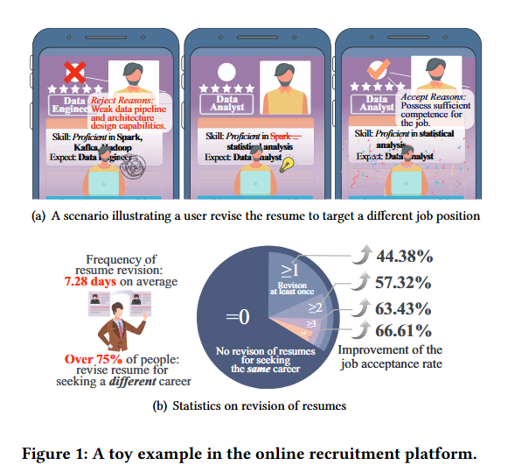
ATAI
Advanced Technique of Artificial Intelligence
ATAI
ChongqingUniversity _{AdvancedTechniqueof}
of Technology Artificial Intelligence
Chongqing University of
Technology
Chongqing University ^{ATAI}
_{of Technology} Advanced Techniqueof
Artificial Intelligence
Chongqing University of Technology
Chongqing University of Technology
Motive
1)On the one hand, content-based job recommender systems, they fall short in capturing job-seeker nuanced job preferences.
2)On the other hand, behavior-based recommendation, their performance is limited by the length of session-based interactions and thus is vulnerable to noise

Slide 3
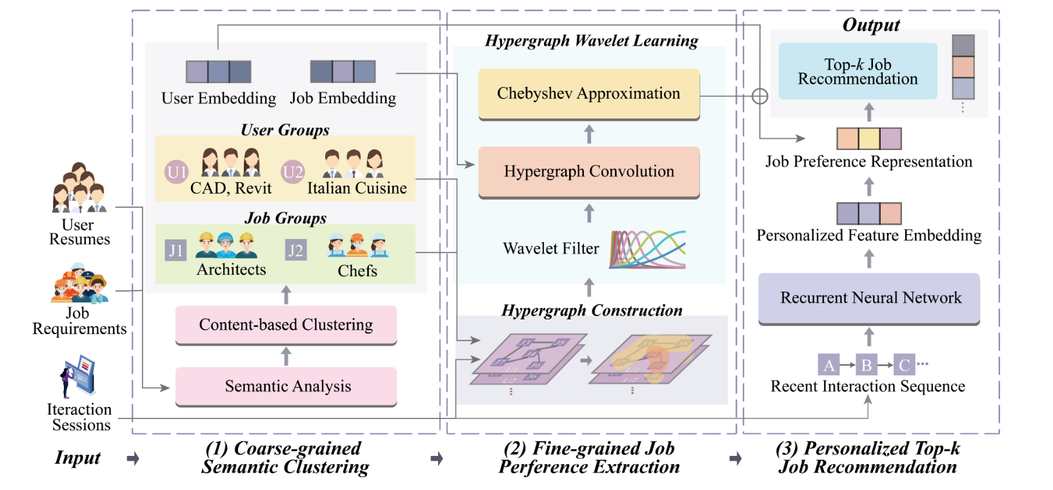
ATAI
ChongqingUniversity _{AdvancedTechniqueof}
of Technology Artificial Intelligence
Chongqing University of
Technology
ATAI
Advanced Technique of Artificial Intelligence
Chongqing University ^{ATAI}
_{of Technology} Advanced Techniqueof
Artificial Intelligence
Chongqing University of Technology
Chongqing University of Technology
Method

Slide 4
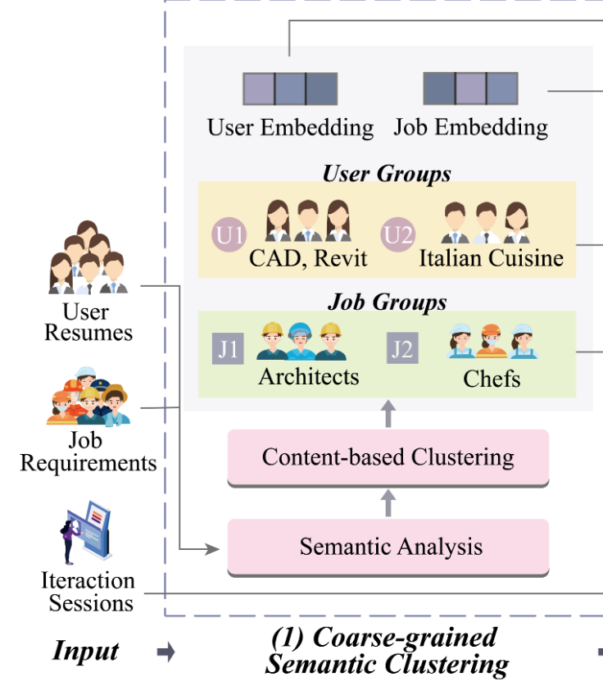
ATAI
Advanced Technique of Artificial Intelligence
ATAI
ChongqingUniversity _{AdvancedTechniqueof}
of Technology Artificial Intelligence
Chongqing University of
Technology
Chongqing University ^{ATAI}
_{of Technology} Advanced Techniqueof
Artificial Intelligence
Chongqing University of Technology
Chongqing University of Technology
Method

Slide 5
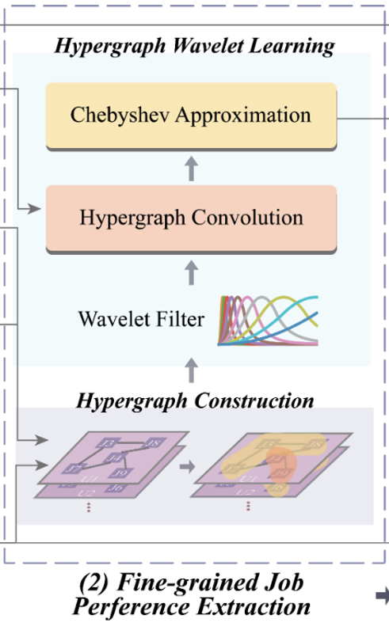
ATAI
Advanced Technique of Artificial Intelligence
ATAI
ChongqingUniversity _{AdvancedTechniqueof}
of Technology Artificial Intelligence
Chongqing University of
Technology
Chongqing University ^{ATAI}
_{of Technology} Advanced Techniqueof
Artificial Intelligence
Chongqing University of Technology
Chongqing University of Technology
Method

Slide 6
ATAI
Advanced Technique of Artificial Intelligence
ATAI
ChongqingUniversity _{AdvancedTechniqueof}
of Technology Artificial Intelligence
Chongqing University of
Technology
Chongqing University ^{ATAI}
_{of Technology} Advanced Techniqueof
Artificial Intelligence
Chongqing University of Technology
Chongqing University of Technology
Method

Slide 7
ATAI
Advanced Technique of Artificial Intelligence
ATAI
ChongqingUniversity _{AdvancedTechniqueof}
of Technology Artificial Intelligence
Chongqing University of
Technology
Chongqing University ^{ATAI}
_{of Technology} Advanced Techniqueof
Artificial Intelligence
Chongqing University of Technology
Chongqing University of Technology
Method

Slide 8
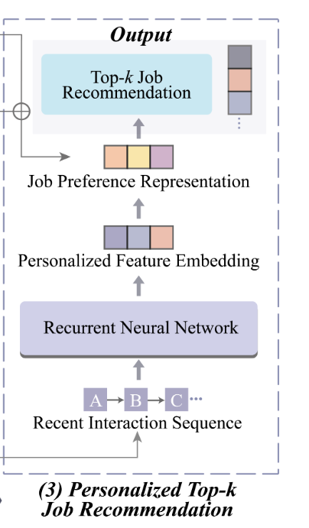
ATAI
Advanced Technique of Artificial Intelligence
ATAI
ChongqingUniversity _{AdvancedTechniqueof}
of Technology Artificial Intelligence
Chongqing University of
Technology
Chongqing University ^{ATAI}
_{of Technology} Advanced Techniqueof
Artificial Intelligence
Chongqing University of Technology
Chongqing University of Technology
Method

Slide 9
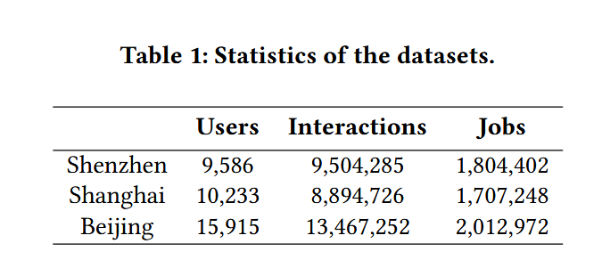
ATAI
Advanced Technique of Artificial Intelligence
ATAI
ChongqingUniversity _{AdvancedTechniqueof}
of Technology Artificial Intelligence
Chongqing University of
Technology
Chongqing University ^{ATAI}
_{of Technology} Advanced Techniqueof
Artificial Intelligence
Chongqing University of Technology
Chongqing University of Technology
Experiments

Slide 10
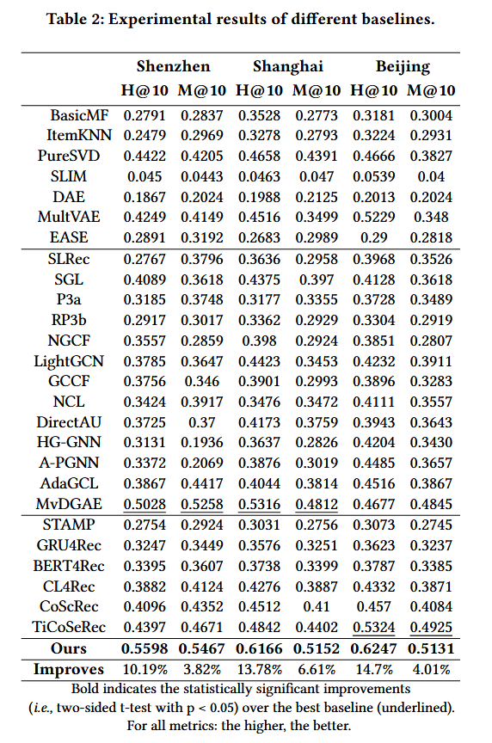
ATAI
Advanced Technique of Artificial Intelligence
ATAI
ChongqingUniversity _{AdvancedTechniqueof}
of Technology Artificial Intelligence
Chongqing University of
Technology
Chongqing University ^{ATAI}
_{of Technology} Advanced Techniqueof
Artificial Intelligence
Chongqing University of Technology
Chongqing University of Technology

Slide 11
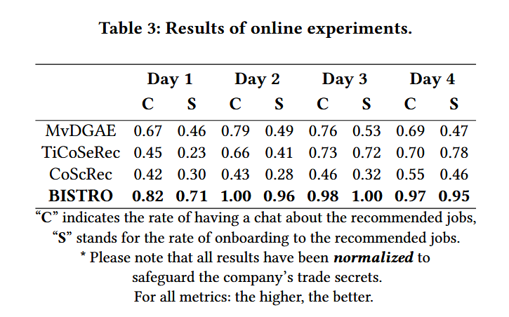
ATAI
Advanced Technique of Artificial Intelligence
ATAI
ChongqingUniversity _{AdvancedTechniqueof}
of Technology Artificial Intelligence
Chongqing University of
Technology
Chongqing University ^{ATAI}
_{of Technology} Advanced Techniqueof
Artificial Intelligence
Chongqing University of Technology
Chongqing University of Technology
Experiments

Slide 12
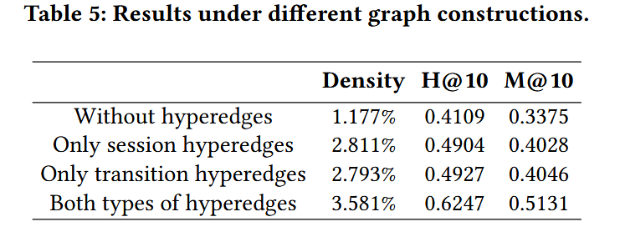
ATAI
Advanced Technique of Artificial Intelligence
ATAI
ChongqingUniversity _{AdvancedTechniqueof}
of Technology Artificial Intelligence
Chongqing University of
Technology
Chongqing University ^{ATAI}
_{of Technology} Advanced Techniqueof
Artificial Intelligence
Chongqing University of Technology
Chongqing University of Technology
Experiments

Slide 13
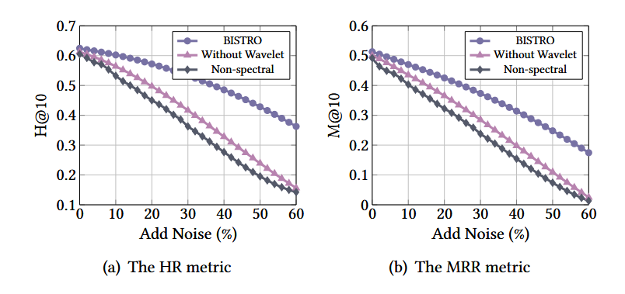
ATAI
Advanced Technique of Artificial Intelligence
ATAI
ChongqingUniversity _{AdvancedTechniqueof}
of Technology Artificial Intelligence
Chongqing University of
Technology
Chongqing University ^{ATAI}
_{of Technology} Advanced Techniqueof
Artificial Intelligence
Chongqing University of Technology
Chongqing University of Technology
Experiments

Slide 14
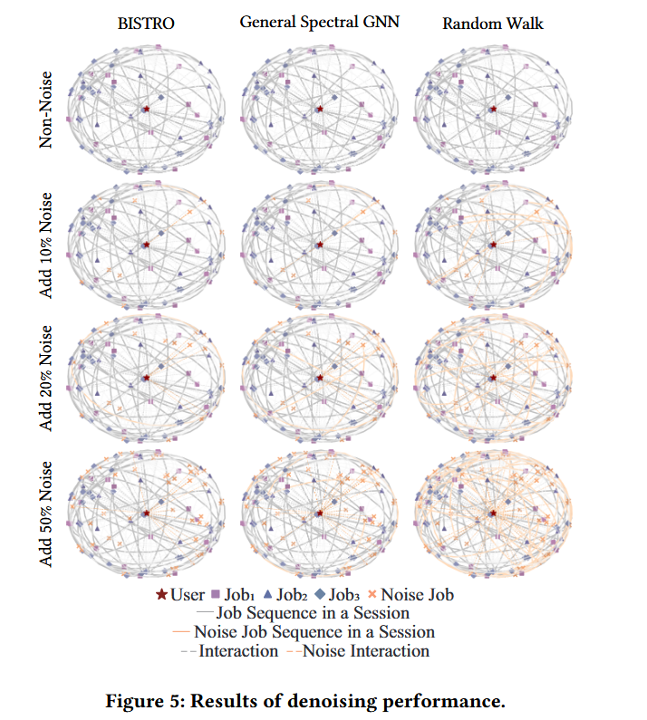
ATAI
Advanced Technique of Artificial Intelligence
ATAI
ChongqingUniversity _{AdvancedTechniqueof}
of Technology Artificial Intelligence
Chongqing University of
Technology
Chongqing University ^{ATAI}
_{of Technology} Advanced Techniqueof
Artificial Intelligence
Chongqing University of Technology
Chongqing University of Technology
Experiments

Slide 15
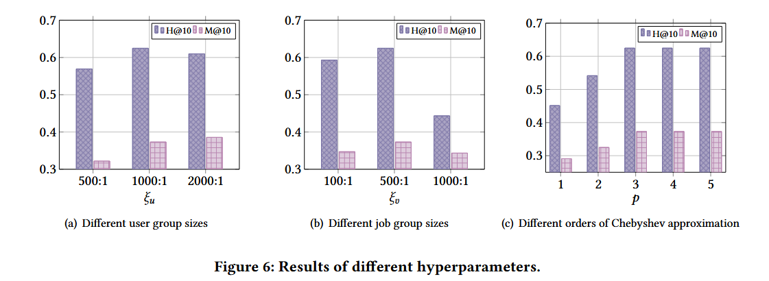
ATAI
Advanced Technique of Artificial Intelligence
ATAI
ChongqingUniversity _{AdvancedTechniqueof}
of Technology Artificial Intelligence
Chongqing University of
Technology
Chongqing University ^{ATAI}
_{of Technology} Advanced Techniqueof
Artificial Intelligence
Chongqing University of Technology
Chongqing University of Technology
Experiments

Slide 16
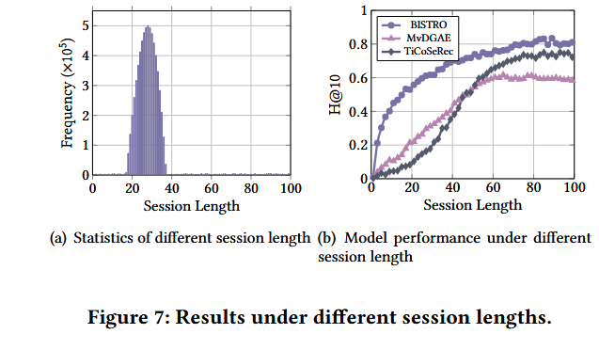
ATAI
Advanced Technique of Artificial Intelligence
ATAI
ChongqingUniversity _{AdvancedTechniqueof}
of Technology Artificial Intelligence
Chongqing University of
Technology
Chongqing University ^{ATAI}
_{of Technology} Advanced Techniqueof
Artificial Intelligence
Chongqing University of Technology
Chongqing University of Technology
Experiments

Slide 17
ATAI
Advanced Technique of Artificial Intelligence
ATAI
ChongqingUniversity _{AdvancedTechniqueof}
of Technology Artificial Intelligence
Chongqing University of
Technology
Chongqing University ^{ATAI}
_{of Technology} Advanced Techniqueof
Artificial Intelligence
Chongqing University of Technology
Chongqing University of Technology
Thanks!

